Slide 1
Development and Validation of Cardiovascular Disease Risk Prediction Tool: A Machine Learning Approach
Richa Sethi

Slide 2
Problem Statement
How can life insurance companies enhance the understanding of cardiovascular disease risk to enable more refined, granular categorizations of risk?
Benefits:
Simplified and streamlined underwriting process
Automated rule sets to bring about less-complex policies
Simpler application forms
Increased value per customer
Improved claims experience

Slide 3
Goal
Develop a Cardiovascular Disease Risk Assessment screening tool to predict risk of heart attack and stroke among adults using self-reported information
Predict the probability of an individual developing cardiovascular disease based on a short questionnaire and evaluate risk score
User Entry
Data Modeling
Insights

Slide 4
Data Sources

Slide 5
Dataset Description
609,36 observations
22 numeric features
Values missing at random
LDL and Triglycerides missing > 55% values

Slide 6
Candidate Variables
Variable | Description
gender | gender
age | age in years
ethnicity | ethnicity/race
income | annual family income
pulse_regular | pulse regular or irregular?
sysbp | systolic blood pressure
diabp | diastolic blood pressure
bmi | body mass Index
waist_circum | waist circumference
hdl | HDL cholesterol (mg/dL)
ldl | LDL cholesterol (mg/dL)
Variable | Description
trigly | triglycerides (mg/dL)
tot_chol | total cholesterol (mg/dL)
diab | doctor diagnosed diabetes
kidney_fail | doctor diagnosed failing kidneys
smoking | smoked at least 100 cigarettes in life
cong_fail | doctor diagnosed congestive heart failure
cor_dis | doctor diagnosed coronary heart disease
angina | doctor diagnosed angina
heart_attack | doctor diagnosed heart attack
stroke | doctor diagnosed stroke
fam_history | close relative had heart disease

Slide 7
Data Wrangling
Filled missing SBP, DBP, Waist circumference, BMI by median
Filled missing Pulse by mode
Filled missing Income values by ffill method
Removed missing LDL and Triglycerides values
Included individuals with Age over 20 years
Replaced ‘Refused’ responses by ‘No health condition’
Formed target variable ‘CVD Risk’ and encoded it as 1 or 0 based on
the heart condition variable values (0 = No, 1 = Yes)

Slide 8
Feature Engineering
20s
30s
40s
50s
60s
70s and above
Lowest
Lower middle
Upper and above
Normal
High
Underweight
Ideal
Overweight
Normal
High
Normal
High/low

Slide 9
Target Distribution
The target variable is highly imbalanced (1:8); appropriate steps may have to be taken to equalize the classes

Slide 10
Feature Overlap
High degree of overlap between classes

Slide 11
Age Distribution
Age of individuals with CVD risk tends to be higher than individuals with no CVD risk

Slide 12
Blood Pressure with Age
As the age increases, the systolic blood pressure increases

Slide 13
Waist Circumference with Age
As the age increases, the waist circumference increases

Slide 14
Relative CVD Risk
CVD Risk increases as age, systolic blood pressure , BMI, waist circumference, triglycerides increase and HDL decreases

Slide 15
Multicollinearity
As expected, variables like LDL, HDL, Triglycerides and total cholesterol, BMI and waist circumference are highly correlated
Will have to be taken care of to develop a robust machine learning algorithm
Heatmap of numeric features

Slide 16
Odds Ratio

Slide 17
Dummy Classifier
Model | PRC AUC | Precision | Recall | ROC AUC
Naïve guess | 0.11 | 0.0868 | 0.060 | 0.51

Slide 18
Base Model Evaluation

Slide 19
Training vs. Validation Set Results
 | Model | PRC AUC | Precision | Recall | ROC AUC
Training Set | Logistic Regression | 0.4235 | 0.5593 | 0.1549 | 0.5697
 | Support Vector Machine | 0.6658 | 0.8824 | 0.1077 | 0.5529
 | Random Forest Classifier | 1.0000 | 1.0000 | 1.0000 | 1.0000
 | kNeighbors Classifier | 0.5265 | 0.7047 | 0.2913 | 0.6397
Validation set | Logistic Regression | 0.4140 | 0.5316 | 0.1338 | 0.5597
 | Support Vector Machine | 0.3799 | 0.5435 | 0.0796 | 0.5357
 | Random Forest Classifier | 0.4143 | 0.5783 | 0.1529 | 0.5697
 | kNeighbors Classifier | 0.2986 | 0.5043 | 0.1847 | 0.5813

Slide 20
Logistic Regression: Resampling
Sampling | PRC AUC | Precision | Recall | ROC AUC
None | 0.4088 | 0.5393 | 0.1529 | 0.5685
Oversampling | 0.3986 | 0.2827 | 0.7994 | 0.7764
Undersampling | 0.3777 | 0.2797 | 0.8089 | 0.7779
SMOTE | 0.3915 | 0.3053 | 0.6369 | 0.7304
SMOTEENN | 0.3981 | 0.2525 | 0.8057 | 0.7579

Slide 21
Support Vector Machine: Resampling
Sampling | PRC AUC | Precision | Recall | ROC AUC
None | 0.3748 | 0.5227 | 0.0732 | 0.5326
Oversampling | 0.3491 | 0.2800 | 0.7134 | 0.7452
Undersampling | 0.3362 | 0.2566 | 0.8376 | 0.7713
SMOTE | 0.3385 | 0.2995 | 0.5446 | 0.6949
SMOTEENN | 0.3548 | 0.2612 | 0.7420 | 0.7435

Slide 22
Random Forest: Resampling
Sampling | PRC AUC | Precision | Recall | ROC AUC
None | 0.4090 | 0.5526 | 0.134 | 0.5603
Oversampling | 0.4065 | 0.5063 | 0.2580 | 0.6137
Undersampling | 0.3699 | 0.2632 | 0.8089 | 0.7669
SMOTE | 0.3535 | 0.3505 | 0.4331 | 0.6678
SMOTEENN | 0.3608 | 0.2720 | 0.7197 | 0.7428

Slide 23
kNeighbors Classifier: Resampling
Sampling | PRC AUC | Precision | Recall | ROC AUC
None | 0.3305 | 0.4196 | 0.1497 | 0.5622
Oversampling | 0.3541 | 0.2767 | 0.5446 | 0.6858
Undersampling | 0.3408 | 0.2519 | 0.7293 | 0.7331
SMOTE | 0.3680 | 0.2579 | 0.6529 | 0.7123
SMOTEENN | 0.4590 | 0.2256 | 0.7643 | 0.7227

Slide 24
Hyperparameter Tuning
Model | Sampling | PRC AUC | Precision | Recall | ROC AUC
Support Vector | Undersampled | 0.5518 | 0.1474 | 0.9686 | 0.5000
Logistic Regression | SMOTEENN | 0.8366 | 0.2147 | 0.9045 | 0.8366
Logistic Regression | Undersampled | 0.8175 | 0.2154 | 0.8535 | 0.8175
Logistic Regression | Oversampled | 0.8273 | 0.2442 | 0.8121 | 0.8273
Random Forest | Undersampled | 0.8474 | 0.2747 | 0.8121 | 0.8474
Logistic Regression SMOTEENN sampled tuned parameters:
{C=0.001, solver='liblinear’}

Slide 25
Feature Importance

Slide 26
Feature Importance
The model over estimates the predictions at higher fractions of true positives

Slide 27
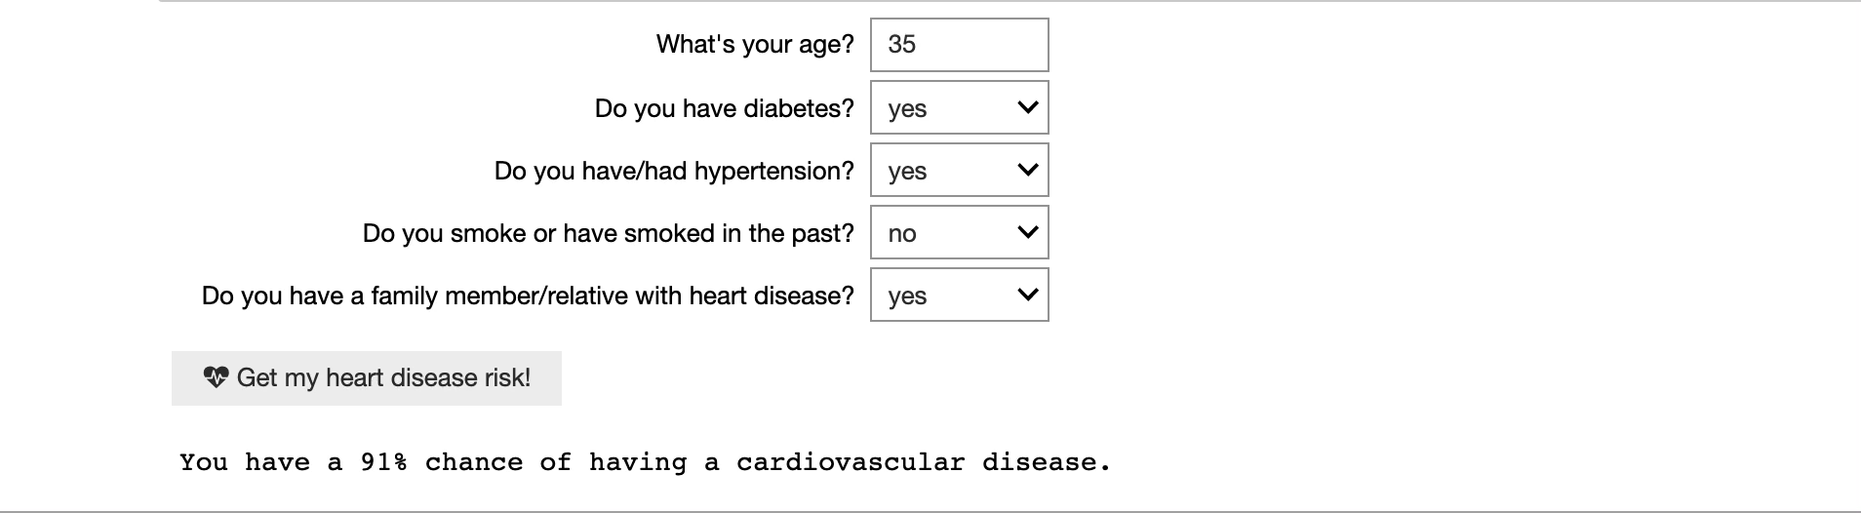
Risk Assessment Tool

